Slide 1
Recurrent Neural Network Sai Kiran 2024

Slide 2
ANN vs RNN
Consider You have Dataset that has text and o/p and the problem statement your solving is Sentimental Analysis.
Now , If we solve this using ANN – First step we do is text pre-processing, which converts text to vectors . Consider we are doing BOW , the output of the BOW is sent to ANN , the sequence of vectors is missing which is basically we are missing the contextual and meaning of the sentence is lost.
Whenever you work on the text data, It is always to have sequence of information, so we will go with RNN where each word is pass during each time frame.
Overview:
ANN can’t maintain the meaningful relationship
It can pass the data sequentially in the timestamp

Slide 3
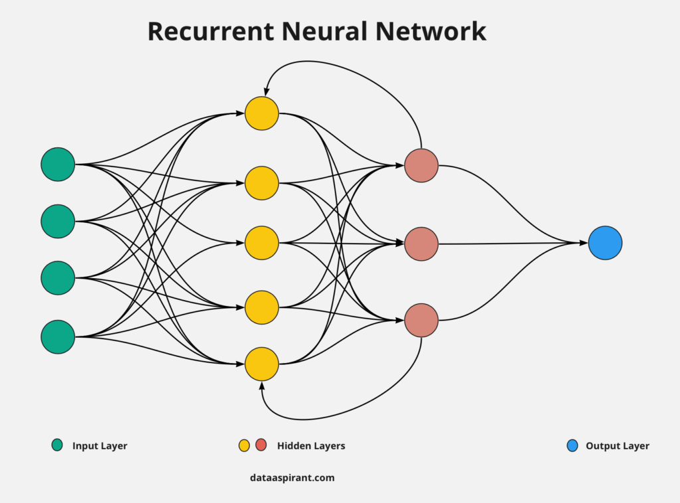
RNN
In Case of ANN , we will have input layer, Hidden Layer and output layer where we have only neurons in all the layer
But in Case RNN, We will have same input Layer, Hidden Layer and Output layer but in the hidden layer neurons we will have feedback loop.
Feedback loop sent the output from the hidden layer it will be sent back to the particular neuron and all the neuron on that particular layer.

Slide 4
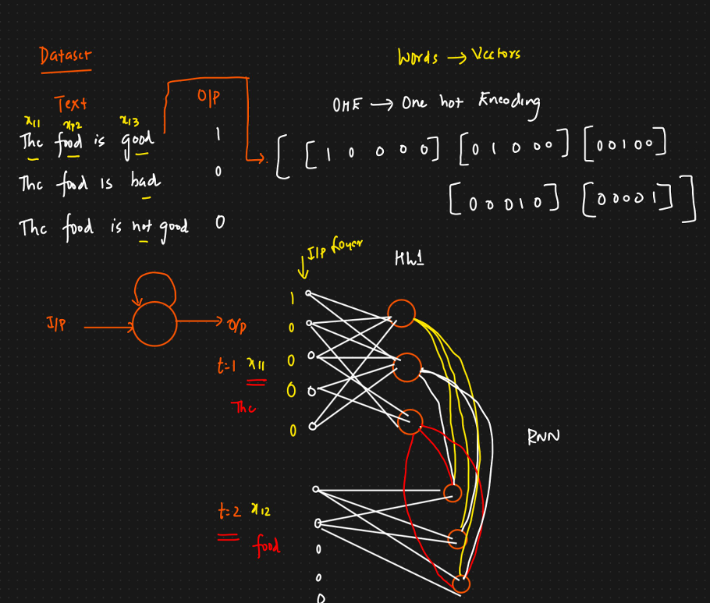
Forward Propagation - RNN

Slide 5
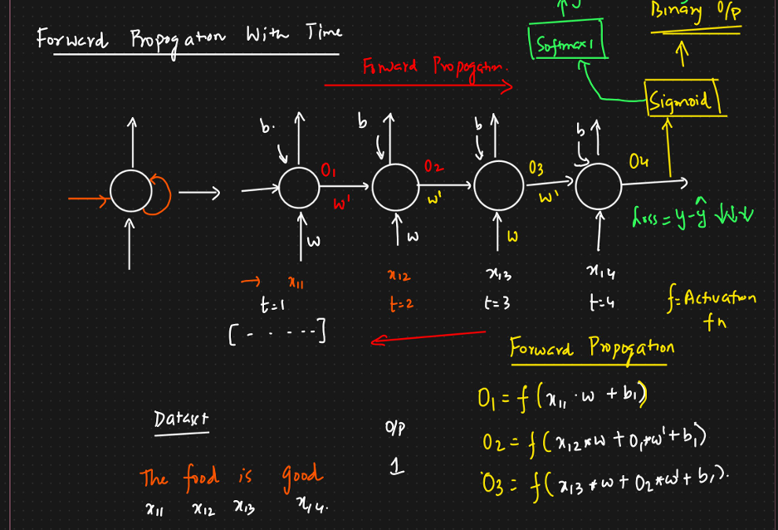
Forward Propagation - RNN

Slide 6
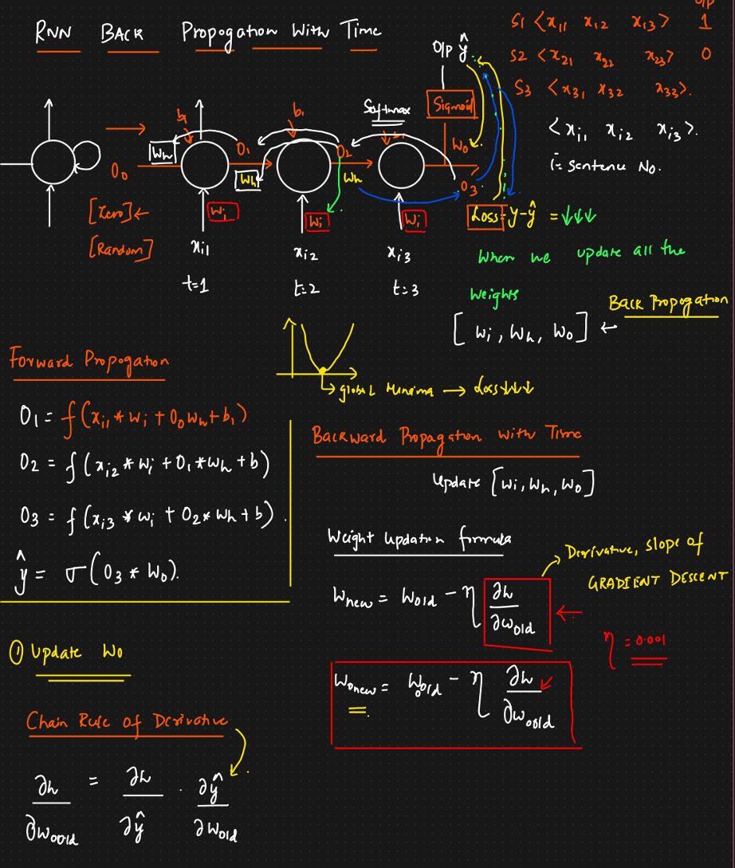
Backward Propagation - RNN

Slide 7
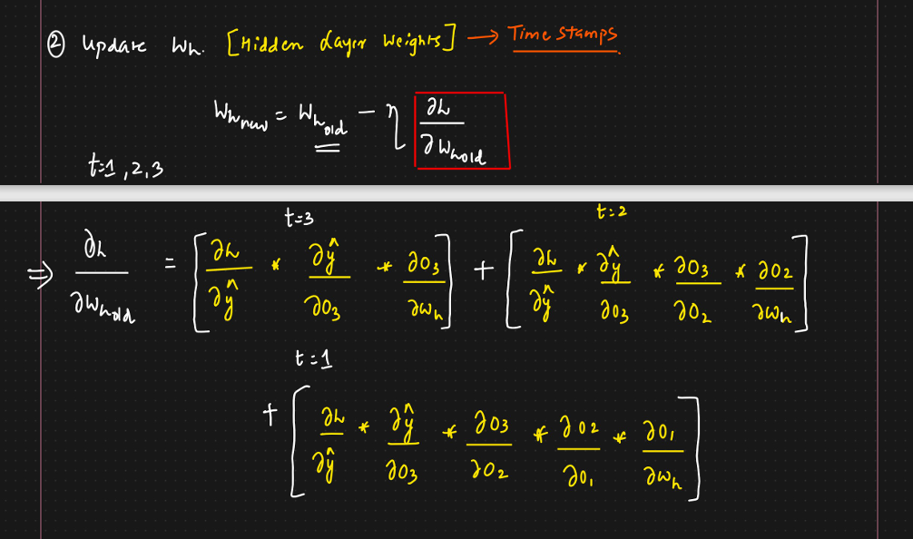
Backward Propagation - RNN

Slide 8
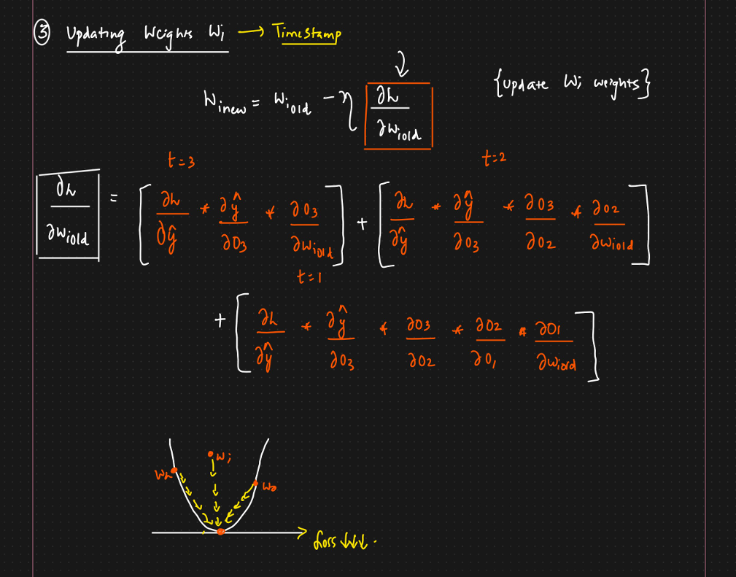
Backward Propagation - RNN

Slide 9
Problems in RNN
Because we have problems in Simple RNN, we will see on LSTM RNN and GRU RNN.
In ANN, we have a important problem called Vanishing Gradient and in Simple RNN we will face this problem.
Consider in Text Generation use case, Each word is dependant on the previous word and its context.
When Generating any word in the sentence, It depends on the few words in the previous words.
Consider you have very long Sentences, like 16 words or so. When you want to predict the 17th word. The dependency of the words on 2 ,4, 5 timestamp is difficult to capture in the Simple RNN.
Consider you have 50 words in sentences . When you try to updates the weight for wh, during the first time stamp the derivative of the value will be ranges 0-0.25 closer to the output and far from the output with be closer to 0 like 0.0001, 0.00025 etc. When you multiply these value the overall result will be 0 or approximate to 0. hence t=1 timestamp weights doesn’t update and hence wont participate in the next word generation. Which Eventually makes the closer words will be having more weightage and the result will be based on that.
To overcome,
Use Relu and Leaky Relu
LSTM RNN
GRU RNN

